Slide 1


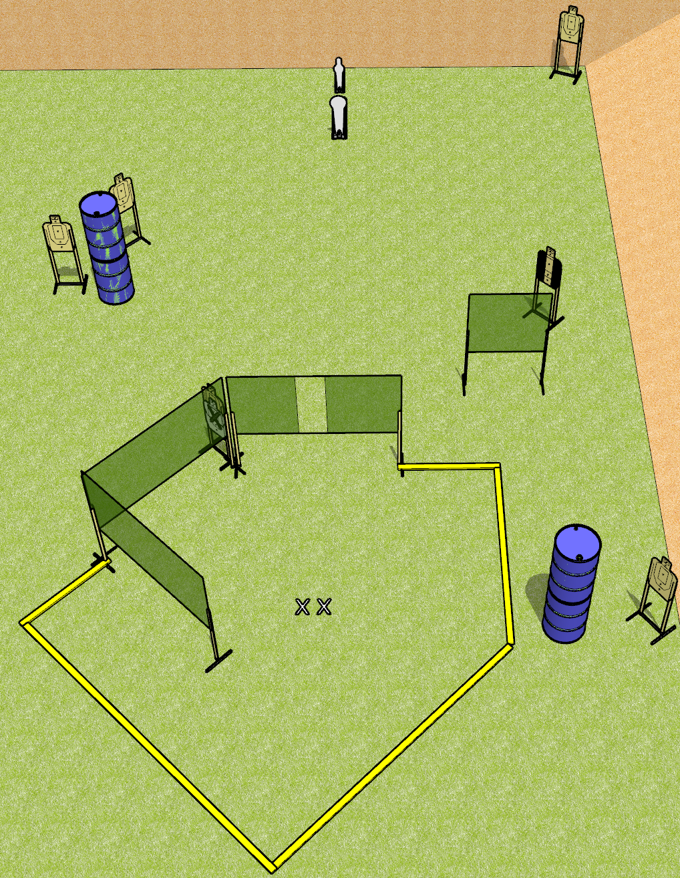
 | Dothan Gun Club – USPSA Match Home Plate Course Designer : Drew Coleman
Round Count 14 rounds 6 paper 1 colt popper, 1 USPSA mini popper
Equipment List 7 wall feet 2 medium fault lines

Slide 2
Home Plate
Written Stage Briefing
Home Plate is a 14 round, 70 point, Comstock medium course. There are 6 USPSA targets, 1 colt popper, and 1 USPSA mini popper. The best two hits on paper will score. The start signal is audible.
Handgun start position is both feet on X’s, wrists below belt. Handgun is loaded and holstered.
PCC start position is both feet on X’s. Loaded carbine is held with both hands, stock on belt, safety on.
On start signal, engage targets as they become available from within the shooting area.

